Slide 1

PROJECT TITLE- Audio And Data Transmission Using LI-FI Technology
Department Of Electronics and Telecommunication Engineering
PROJECT PRESENTATION - 2
PRESENTED BY:
1.ROHIT SANJAY BOBADE (160)
2.YASHODEEP D. DESHMUKH (164)
3.SARVESH SANJAY MALI (177)
GUIDED BY :
MS. NILIMA S. WARADE

Slide 2
INTRODUCTION
As we presumably mindful, nowadays, web has become a huge interest and people are in steady need of remote fidelity (Wi-Fi). Light Fidelity (Li-Fi) advancement uses light beams as opposed to radio waves to send information. The other name given to it is optical variation of Wi-Fi It is one of the latest advancement that uses Light Emitting Diodes (LED). It is a 5g innovation of obvious light correspondence framework. It gives us better productivity, transmission capacity, security and accessibility than Wi-Fi. It predicts the future where the information for smart phones, PC and tablet is transmitted and gotten through the light in a room s. It might be used in high security military domains.
Li-Fi is a transmission of data using evident light by sending data through a LED light that vacillates in power snappier than the regular eye can follow. The chance of Li-Fi was introduced by a German physicist Harald Hass, which he furthermore suggested as "Data through edification". The overall term perceptible light correspondence joins any usage of the undeniable light piece of the electromagnetic range to communicate information. Haas propelled this development in his 2011 TED Global talk and helped start an association to promote it. Both Li-F and Wi-Fi utilize electromagnetic range for information transmission. While Wi-Fi utilizes radio waves, Li-Fi utilizes visible light communication in the scope of 500 Mbps. This paper talks about the working, executions and improvement in Li-Fi innovation.

Slide 3
LITERATURE SURVEY
IEEE ANTS 2019 :
Visible Light Communication (VLC) is the term which was the method that uses visible light for Data transmissions. Due to the insufficient Radio Frequency(RF) resources, and the limitations in bandwidth, the demand for faster data transmission becomes a big problem to be solved. This problem is rectified by the emerging Li-Fi technology which provides faster data transmission with a more secure environment. Therefore, VLC became an emerging technology and was included in 5g. This paper focuses on audio and video transmissions in VLC methodology using Li-Fi (light fidelity) module. A real-time transmitter and receiver system to check the performance and verify the audio and video transmission using Li-Fi under varying conditions such as distance, intensity, and quality.
IEEE(I-SMAC)2020 :
As the demand for high-speed data in wireless communications increases day by day with the significant increase of the number of users, Radio Frequency (RF) spectrum become one of the scantest resources in the world. RF technologies have limitations of the regulated spectrum, spectrum congestion, expensive licensing, low bandwidth and low bandwidth and low-speed broadband connection.

Slide 4
JETIR 2019 :
Continuous improvements in wireless communication systems, e.g. 3G, 4G, etc.., require higher bandwidth and due to the lack of sufficient Radio Frequency spectrum, we should adopt a wireless system which will support wide bandwidth. So the new technology of Li-Fi came into the aid. Light fidelity (Li-Fi) is a new short range optical wireless communication technology which provides data transmission like text, audio, video by using Light-Emitting Diodes (LEDs) to transmit data depending on light illumination properties . It uses the visible light spectrum which is 10,000 times larger than the entire radio frequency spectrum.
ICMSMT 2020 :
The light fidelity technology refers to visible light communication that uses light as a medium to deliver high speed data which is much greater than that of Wi Fi. Li Fi data is transmitted in several bit streams and the receiver side consisting an IR detector decodes the message. The transmission happens in the form of binary data where 0 means LED in OFF state and 1 means that the LED is in the ON state. Transmitter and receiver sections contain Arduino which is programmed using Arduino IDE. High power intensity led are used in the Li Fi transmitter. In receiver section photodiode module is used to detect the light signal generated by the Li Fi transmitter. In this we are transmitting the 2 different data using light they are Audio signal and Text Signal.

Slide 5
PROBLEM STATEMENT
As the demand for high-speed data in wireless communications increases day by day with the significant increase of the number of users, Radio Frequency (RF) spectrum become one of the scantest resources in the world. RF technologies have limitations of the regulated spectrum, spectrum congestion, expensive licensing, low bandwidth and low bandwidth and low-speed broadband connection.
So the new wireless technology known as light fidelity (Li-Fi ) has become a new source for communication of data. which uses visible light as a medium to deliver high-speed data communication. It Uses available huge visible light communication (VLC) spectrum band ranges from 428 THz to 750 THz.

Slide 6
AIM & OBJECTIVES
Aim: Audio And Data Transmission using Li-Fi Technology
OBJECTIVES : To Transfer Audio And Data Using Visible Light Communication (VLC), Light Fidelity (Li-Fi) Technology Has Been Designed. This Project Aims To Develop a System For Faster And More Secure Transmission of Data.

Slide 7
METHODOLOGY
If the LED is on, we transmit a digital 1, if it’s off you transmit a 0.
The LEDs can be switched on and off very quickly, which gives nice opportunities for transmitting data. Hence all that is required is some LEDs and a controller that code data into those LEDs.
All has to do is to vary the rate at which the LED’s flicker depending upon the data we want to encode.
The flashing of the light actually happens much faster that human eyes cannot detect, so the output appears constant, allowing for a Li-Fi data connection to resemble a simple LED bulb When LED is ON microchip convert digital data in form of light. On the other end this light is detected by the photo detector.
Then this light is amplified and fed to the device. If the LED is ON, transmit a digital 1, if it’s OFF you transmit a digit 0.

Slide 8
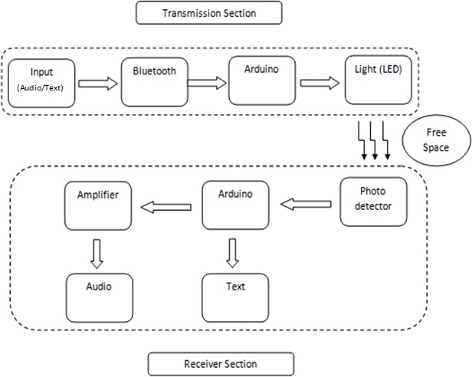
BLOCK DIAGRAM

Slide 9
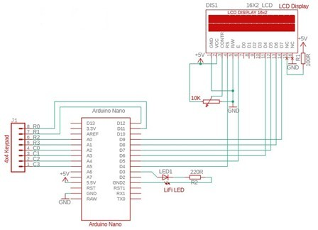
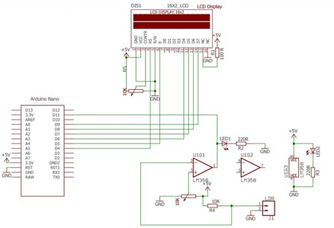
CIRCUIT DIAGRAM

Slide 10
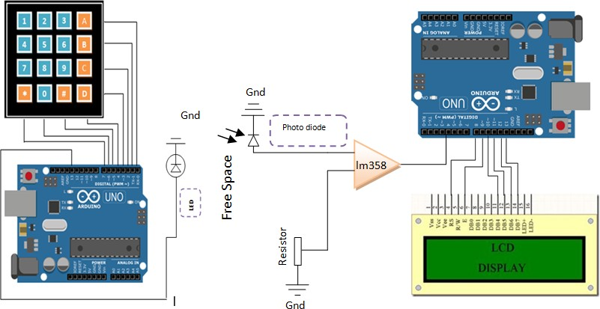
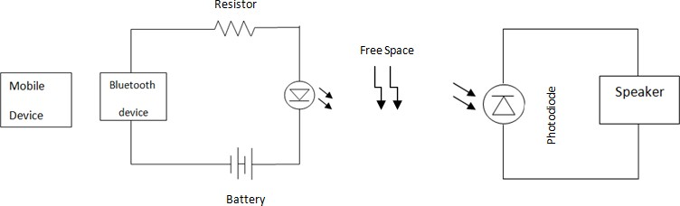

Slide 11
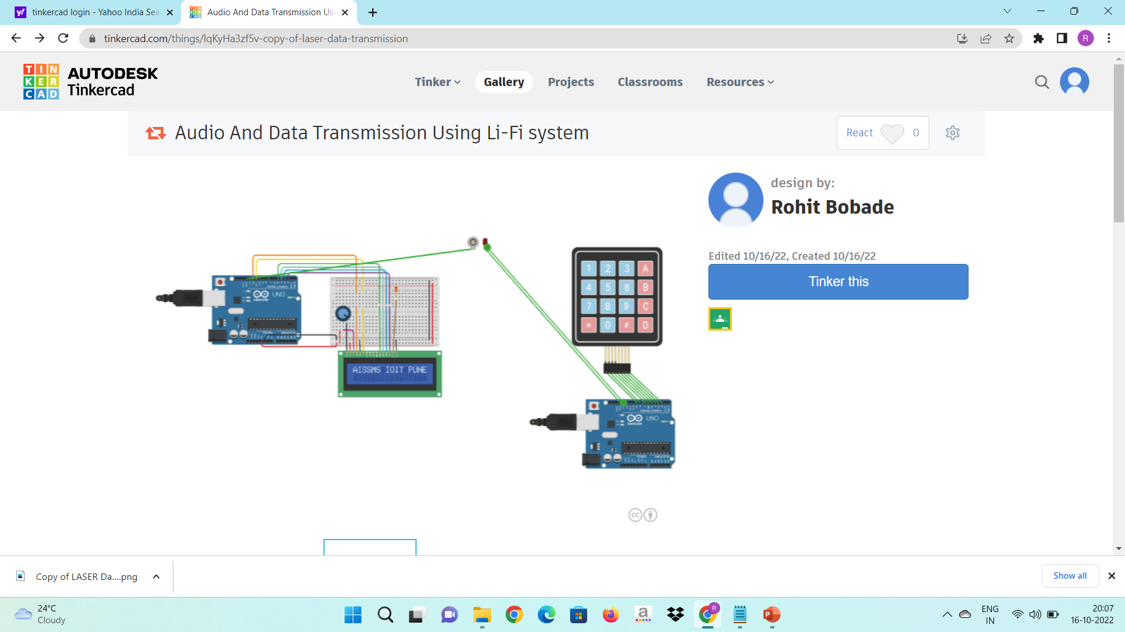
Simulation Results
Link- https://www.tinkercad.com/things/lqKyHa3zf5v

Slide 12
CONCLUSION
In this project, proposed, explained and demonstrated a real- time text and audio broadcast prototype by using LED and solar panel and examine the transmission of both text and audio signals using visible light communication. It is observed that transmission of text with the distances up to 0.5m and transmission of audio with distances up to 1.5m can be achieved. The VLC technology will be more explored in near future as demand for high-speed communication increases with application to transportation and home network.

Slide 13
REFERENCES
[1] Satya Jaswanth, Badri Computer Science and Engineering Indian Institute of Technology, Ropar satyajaswanth.badri@gmail.com "Audio and Video Transmission Using Visible Light Transmission" ANTS 1570-566372 ©2019 IEEE
[2] Sabita Mali, Department of EIE, ITER Siksha ‘O’ Anusandhan (Deemed to be University) Khandagiri Square Bhubaneswar-751030, Odisha, India "Design and Implementation of Text and Audio Signal Transmission using Visible Light Communication." -978-1-7281-5464-0/20/$31.00 ©2020 IEEE.
[3] Shabana Parveen M1, Siddarthan K2,Vignesh T3, Ajay Krishnaa A R4 Data transmission using Li-Fi technology www.jetir.org (ISSN-2349-5162)©2019 JETIR.
[4] G Madhuri, K Anjali and R Sakthi Prabha Department of Electronics and Communication Engineering, Sathya bama Institute of Science & Technology, Chennai, India “Transmission of data, audio and text signal using Li-fi. technology “ IOP Conf. Series: Materials Science and Engineering 872 (2020) 012010
IOP Publishing doi:10.1088/1757-899X/872/1/012010.
[5] Rosilah Hassan Faculty of Information Science & Technology . Universiti Kebangsaan Malaysia
43600 UKM, Bangi, Selangor, "MALAYSIA Visibile Light Communication Technology For Data
Transmission Using Li-Fi" 978-1-7281-5467-1/20/$31.00 ©2020 IEEE
[6] Umesh Pant E&CE “Department National Institute of Technology,”
Hamirpur, Himachal Pradesh Analog/Digital Data Transmission using Li-Fi 978-1-7281-6575-2/20/$31.00 ©2020 IEEE

